Slide 2
Treating Network Assets as Schedulable Resources
Vinothkumar Siddharth, Amazon EKS

Slide 3
Who am I?
Software Engineer
Amazon EKS
Past (Software Engineer)
Amazon ECS
Citrix Systems R&D, Xen/XAPI Project

Slide 4
Agenda
Overview
CNI
Container Scheduling
Key Challenges
Solution
Demo

Slide 5
Overview of CNI

Slide 6
What is CNI?
Highly overloaded term!
Notes:
https://github.com/containernetworking/cni/blob/spec-v0.3.1/SPEC.md

Slide 7
What is CNI?
What is CNI?
Spec (v0.3.1)
Add
Del
Version
Spec (v0.4.0)
Notes:
https://github.com/containernetworking/cni/blob/spec-v0.3.1/SPEC.md

Slide 8
What is CNI?
What is CNI?
Collection of plugins
bridge, loopback, ptp, vlan, …
win-bridge, win-overlay
dhcp, host-local, static
flannel, portmap,
Notes:
https://github.com/containernetworking/cni/blob/spec-v0.3.1/SPEC.md

Slide 9
What is CNI?
What is CNI?
Library
Notes:
https://github.com/containernetworking/cni/blob/spec-v0.3.1/SPEC.md

Slide 10
CNI Recap
What is CNI?
Spec (v0.3.1)
Add
Del
Version
Library
Collection of base plugins
More!
Notes:
https://github.com/containernetworking/cni/blob/spec-v0.3.1/SPEC.md

Slide 11
CNI Kubelet Interaction
How kubelet and CNI interact ?
At least one invocation of the CNI plugin binary per Sandbox.

Slide 12
CNI Kubelet Configuration
Kubelet Configuration
“--network-plugin”
“--cni-bin-dir”
“--cni-conf-dir”

Slide 13
CNI Deployment
Typical CNI deployments
CNI plugin binary
CNI config
Node level daemon
Notes:
// TODO: Add EKS VPC Plugin

Slide 14
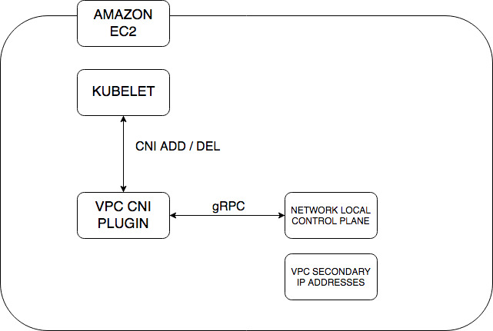
CNI Deployment
Typical CNI deployments
CNI plugin binary
CNI config
Node level daemon

Slide 15
Container Scheduling

Slide 16
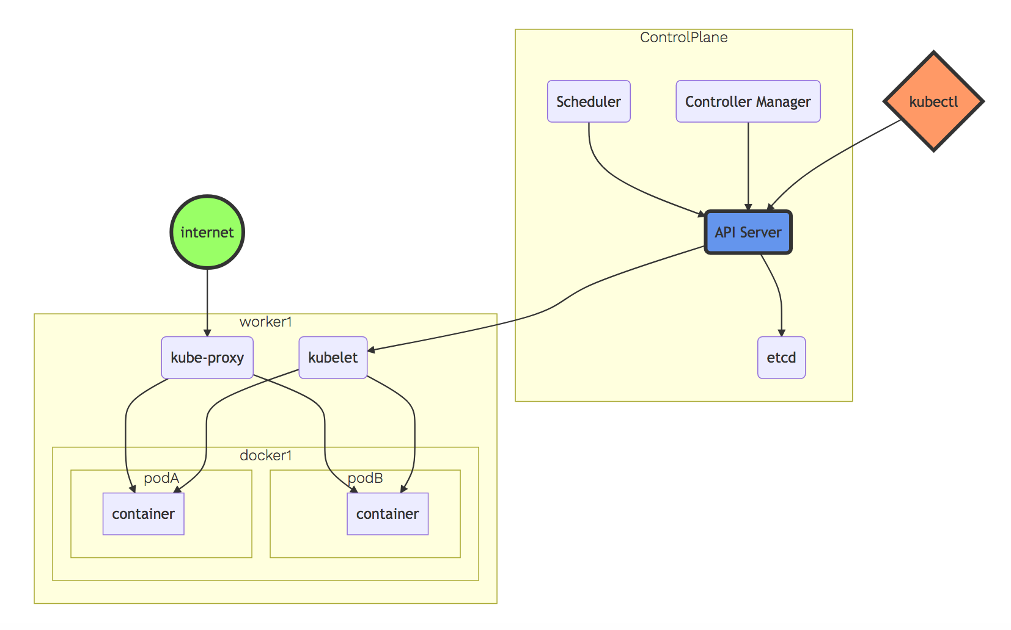
Kubernetes Architecture
Notes:
// TODO: Find better diagram

Slide 17
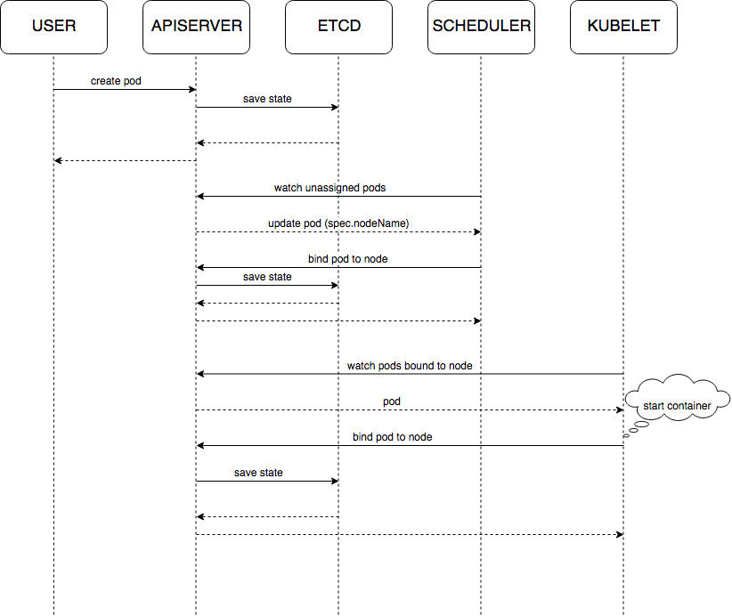
Kube-Scheduler

Slide 18
Kube-Scheduler
Find nodes for pods in a cluster
Complex and feature rich
Multiple dimensions to optimize
Default Scheduler:
Accounts for CPU and memory in the scheduling process!
Supports resource based scheduling
Notes:
https://kubernetes.io/docs/reference/command-line-tools-reference/kube-scheduler/

Slide 19
Kube-Scheduler: Resource Based
apiVersion: v1
kind: Pod
spec:
containers:
- command: …
resources:
limits:
cpu: “500m”
memory: “1500Mi”
requests:
cpu: “500m”
memory: “1500Mi”

Slide 20
Custom Schedulers
Kubernetes provides a framework to incorporate custom schedulers for special needs!
Typical deployment managed by the default scheduler.
spec.schedulerName: <special-purpose-scheduler>
Kubernetes enables multiple schedulers within the cluster.
Notes:
// TODO: Add more details

Slide 21
Challenges

Slide 22
Challenges
How to account for networking assets in the scheduling process?

Slide 23
Challenges
How to eliminate the node level agent running on worker nodes?

Slide 24
Challenges
How to minimize the permissions required to manage the lifecycle of networking assets?

Slide 25
Solution

Slide 26
Solution
Use extended resources
Custom resource controllers
Admission webhooks
CNI plugin

Slide 27
VPC Resource Controller
Manages VPC resources for the cluster
Pluggable resource model
Provider interface
Platform agnostic

Slide 28
VPC Resource Controller: Provider
type Provider interface { GetResourceName() string GetDesiredWarmPoolSize() (int, int) InitResourcePool(node Node) (*Pool, error) CreateResource(node Node, quantity int) (resourceIDs []string, err error) DeleteResource(node Node, resourceID string) error }

Slide 29
VPC Resource Controller: Provider
Provider Interface Implementations
Elastic Network Interface Provider
IP Address Provider

Slide 30
VPC Resource Controller: Responsibilities
Watch for node objects
Advertise extended resources

Slide 31
VPC Resource Controller: Responsibilities
apiVersion: v1
kind: Node
spec:
providerID: aws:///us-west-2a/i-094fe8fb054fd0b07
status:
allocatable:
cpu: "4"
memory: 8023644Ki
pods: "110"
vpc.amazonaws.com/ENI: "1"
vpc.amazonaws.com/PrivateIPv4Address: "14"
capacity:
cpu: "4"
memory: 8023644Ki
pods: "110"
vpc.amazonaws.com/ENI: "1"
vpc.amazonaws.com/PrivateIPv4Address: "14"
Watch for node objects
Advertise extended resources

Slide 32
VPC Resource Controller: Responsibilities
Watch for pod objects
Annotate pod spec with metadata

Slide 33
VPC Resource Controller: Responsibilities
Watch for pod objects
Annotate pod spec with metadata
apiVersion: v1
kind: Pod
metadata:
annotations: vpc.amazonaws.com/PrivateIPv4Address: 192.168.113.175
name: windows-servercore-webserver-5659f96674-cts74
namespace: default
spec:
containers:
- command: …
name: windows-servercore-webserver
resources:
limits:
vpc.amazonaws.com/PrivateIPv4Address: "1"
requests:
vpc.amazonaws.com/PrivateIPv4Address: "1"

Slide 34
VPC Admission Webhook
Inject extended resource requirements for relevant pods

Slide 35
VPC Admission Webhook
Inject extended resource requirements for relevant pods
apiVersion: v1
kind: Pod
metadata:
annotations:
vpc.amazonaws.com/PrivateIPv4Address: 192.168.113.175
name: windows-servercore-webserver-5659f96674-cts74
namespace: default
spec:
containers:
- command: …
name: windows-servercore-webserver
resources:
limits:
vpc.amazonaws.com/PrivateIPv4Address: "1"
requests: vpc.amazonaws.com/PrivateIPv4Address: "1"

Slide 36
CNI Plugin: VPC Shared ENI
Simple executable (binary)
Read pod metadata
Annotations
Provides
Connectivity
Reachability

Slide 37
Demo

Slide 38
Benefits
Incorporate network resources in the scheduling process
Eliminate long running node local agents
Obtain VPC level network resource accounting per cluster
Easy to add support for new VPC resource abstractions
Reduced set of permissions on worker nodes

Slide 39
Thank You!

Slide 40
Q&A

Slide 41
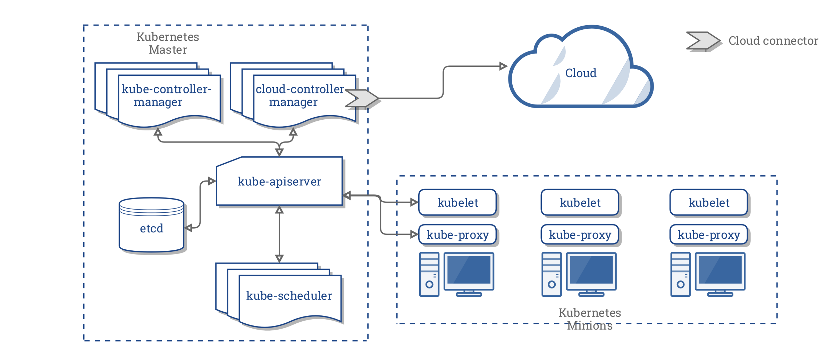
Kubernetes Architecture
Notes:
// TODO: Find better diagram

Slide 42
Kube-Scheduler: General Scheduling
POD: 1
CPU: 1
Memory: 2
POD: 2
CPU: 3
Memory: 8
Node: 0
CPU: 2
Memory: 4
Node: 1
CPU: 2
Memory: 4
Node: 2
CPU: 4
Memory: 8
Node: 3
CPU: 4
Memory: 8
Notes:
// TODO: Find better diagram

Slide 43
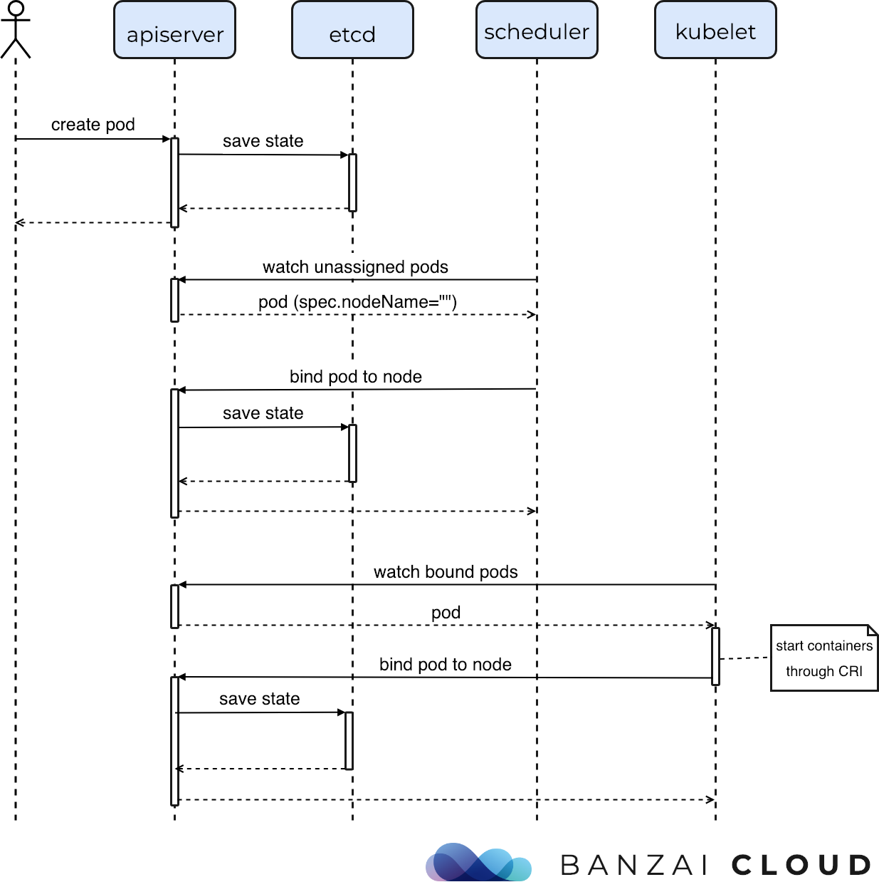
Kube-Scheduler
Notes:
https://kubernetes.io/docs/reference/command-line-tools-reference/kube-scheduler/
// TODO: Update diagram

